Slide 1

SC1015
Mini Project
Predicting Stock Price
using Economic Indicators
SC14 - Group 1
Kai Seong, Julian, Horstann
Notes:
1) Sample Collection [FRED] / Practical Motivation [hype towards ML, explore and see if predictive models are really that good]
2) Data Preparation [LSTM & its accuracy and df_full] / Problem Formulation [Determine whether accuracy of traditional prediction model is reliable ie. can it sustain profits]
3) Exploratory Analysis / Statistical Description [time series graph, heatmap of correlations]
4) Analytic Visualization [de-trend] / Pattern Recognition
5) Algorithmic Optimisation / Machine Learning [Polynomial Regression]
6) Info Presentation / Statistical Inference [Compare & Contrast]
7) Ethical Consideration / Intelligent Decision [Past is not an indication of the future, put more importance on understanding economic situations and market sentiment]

Slide 2

02
Practical
Motivation
hype towards ML
explore predictive models
Notes:
recently, hype towards ML
Current state of the art:
- extremely complex predictive models (e.g. LSTM) are popularly used to predict stock prices
- many financial firms and organisations rely on these models for risk management and profit maximisation
explore predictive models, are they as good as they seem to be?

Slide 3
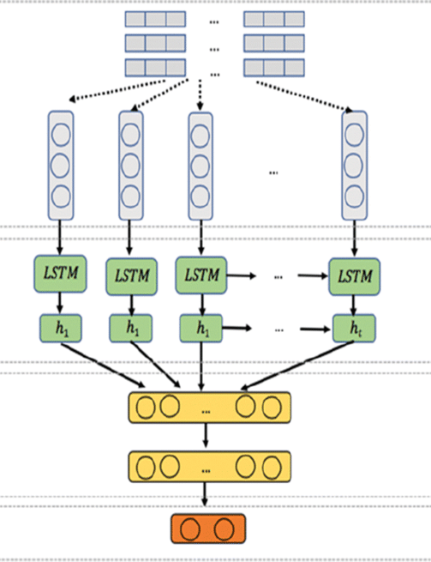
03
Problem
Formulation
How reliable are popular prediction models?
Can we make better predictions?
Notes:
Are these models (in out case, we'll be looking at LSTM - a popular ... briefly explain) really reliable? Do they have any weaknesses?
Can we produce more reliable predictions using alternative models (in our project we explore multiple polynomial regression)?

Slide 4
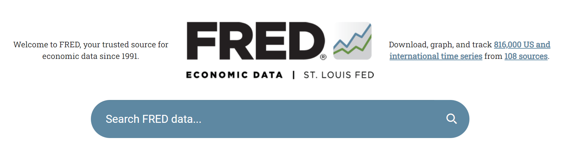
04
Sample
Collection
Notes:
mention applying for a key, requesting data from the API and combine them in df_full

Slide 5
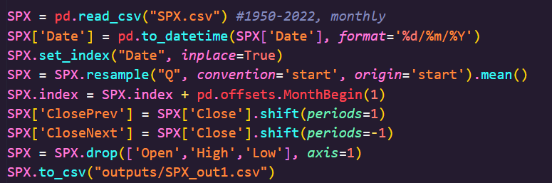
05
Data Preparation
Concat dataframes, Drop Null Values, Resample Data, Format Datetime, Shift Rows, Concat Dataframes, Reset Indexes, Remove Outliers
Notes:
say wtv we did to format the data for our models

Slide 6
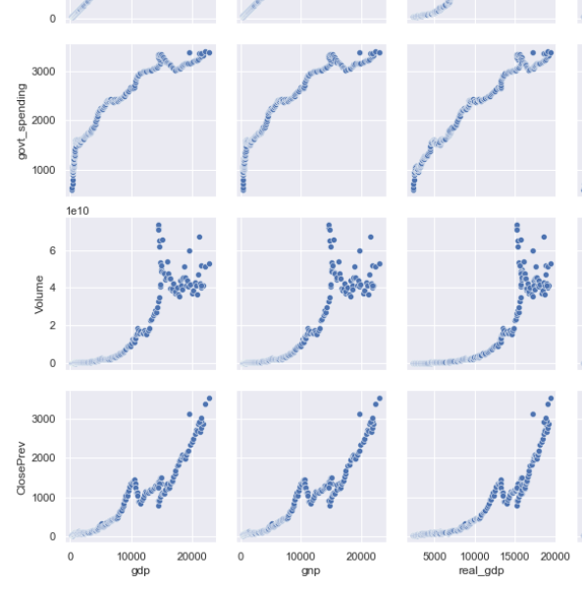
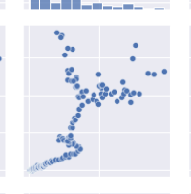
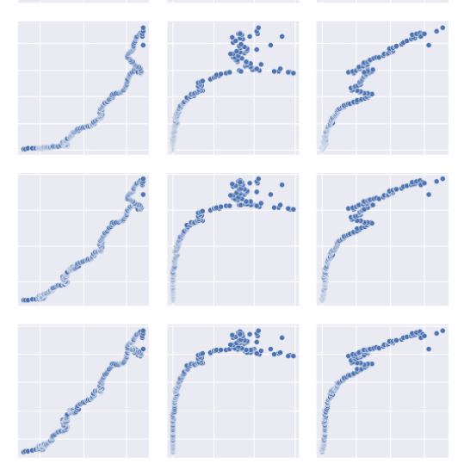
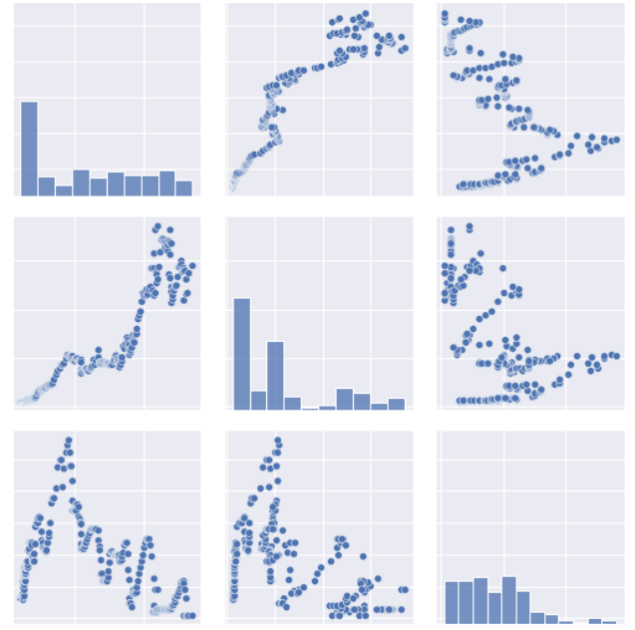
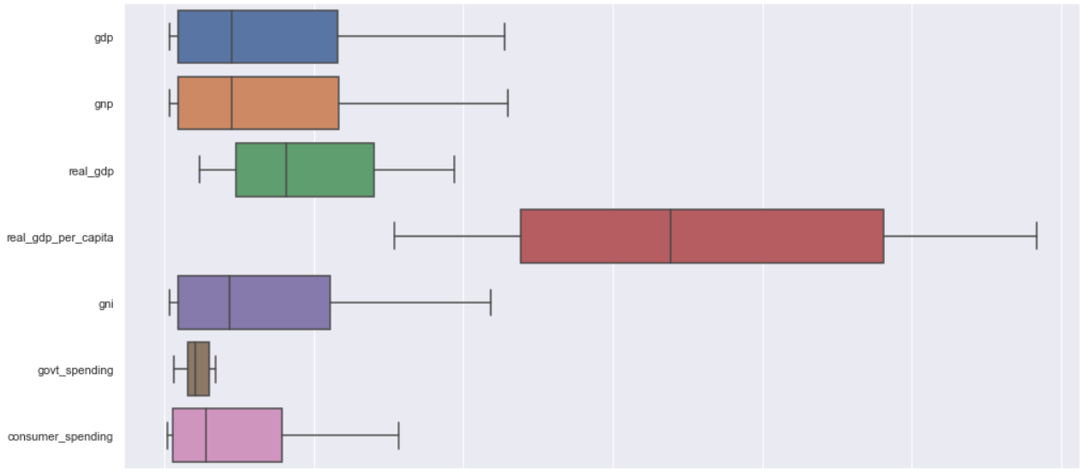
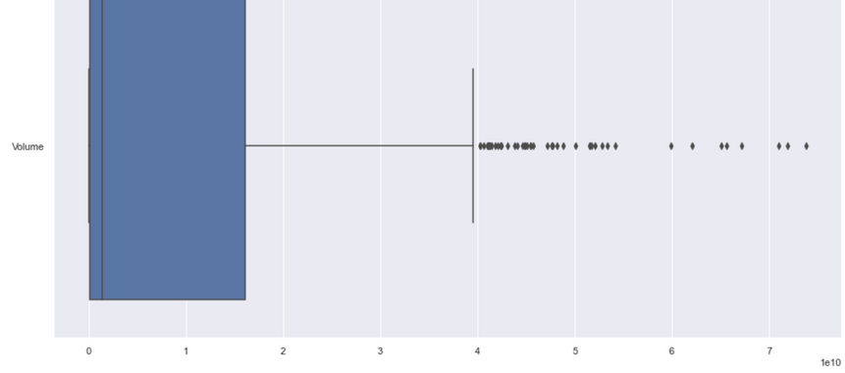
06
Exploratory
Analysis
Box plots and pair plots
Notes:
We ran a few EDAs like boxplots and pairplots.
The pairplots gave us very interesting patterns as seen here.

Slide 7
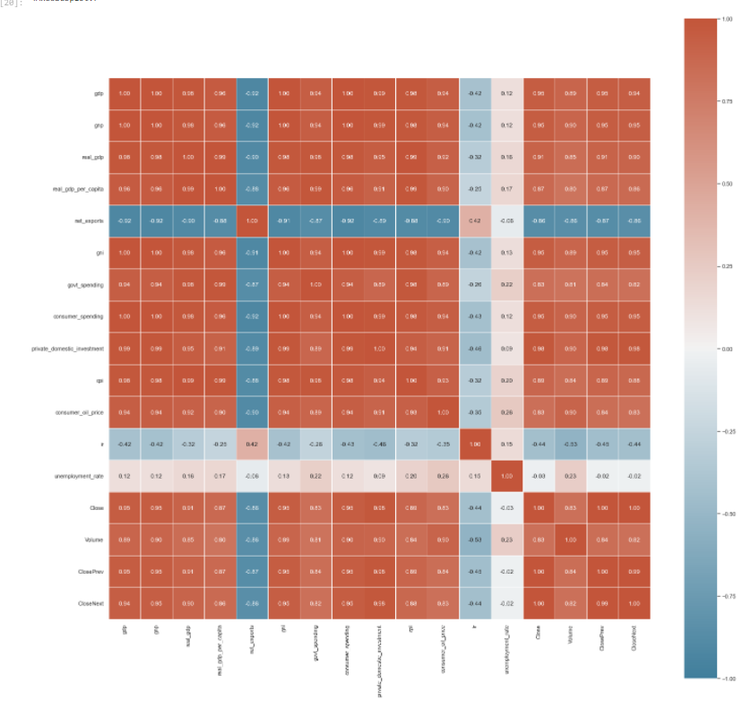
06
Exploratory
Analysis
Correlation matrix
Notes:
But what caught our eye was the correlation matrix, lots of these variables are very highly correlated to one another. Almost too good to be true
So this could be an issue of trend (explain)

Slide 8
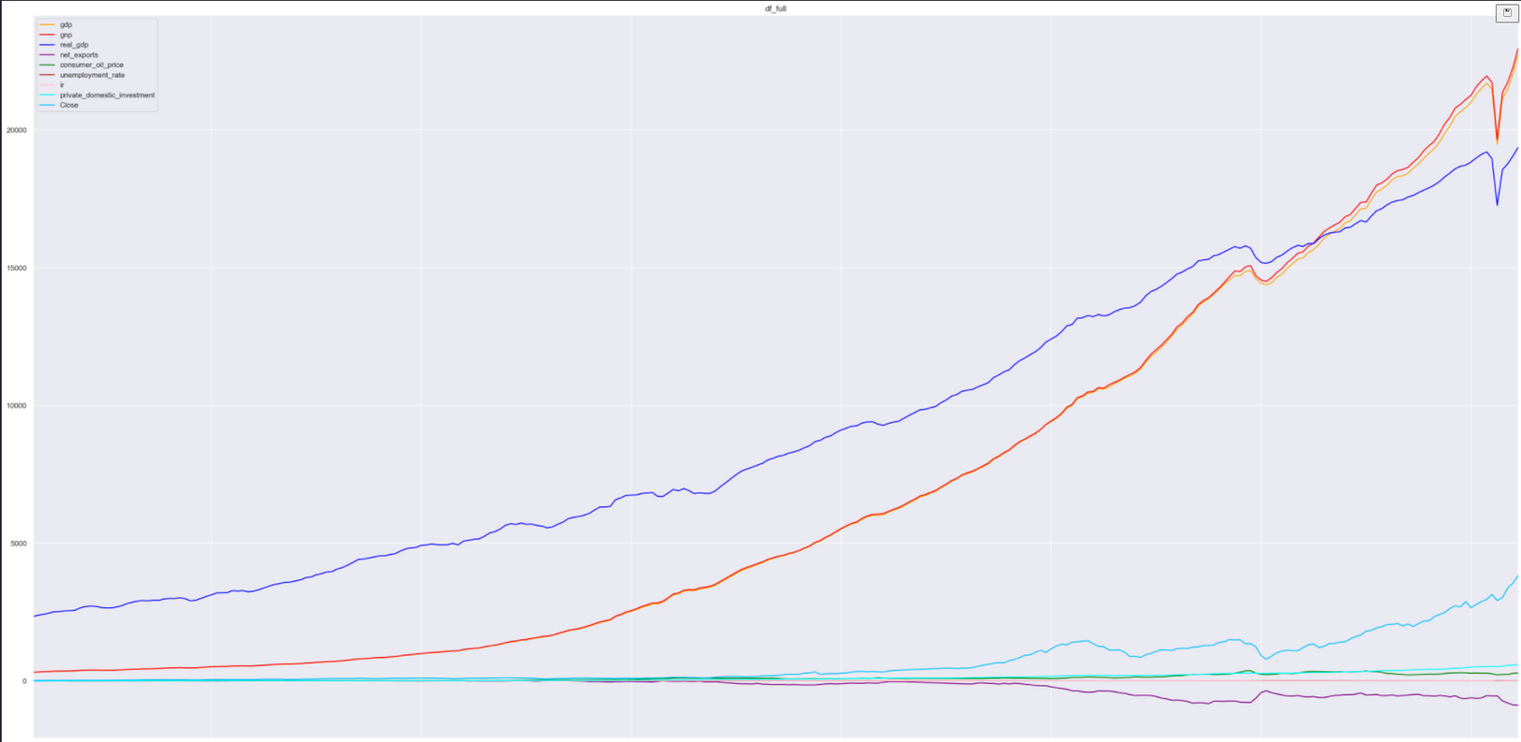
06
Exploratory
Analysis
Time series graph
Notes:
After looking at the whole time series graph, we realise that trend was indeed an issue

Slide 9
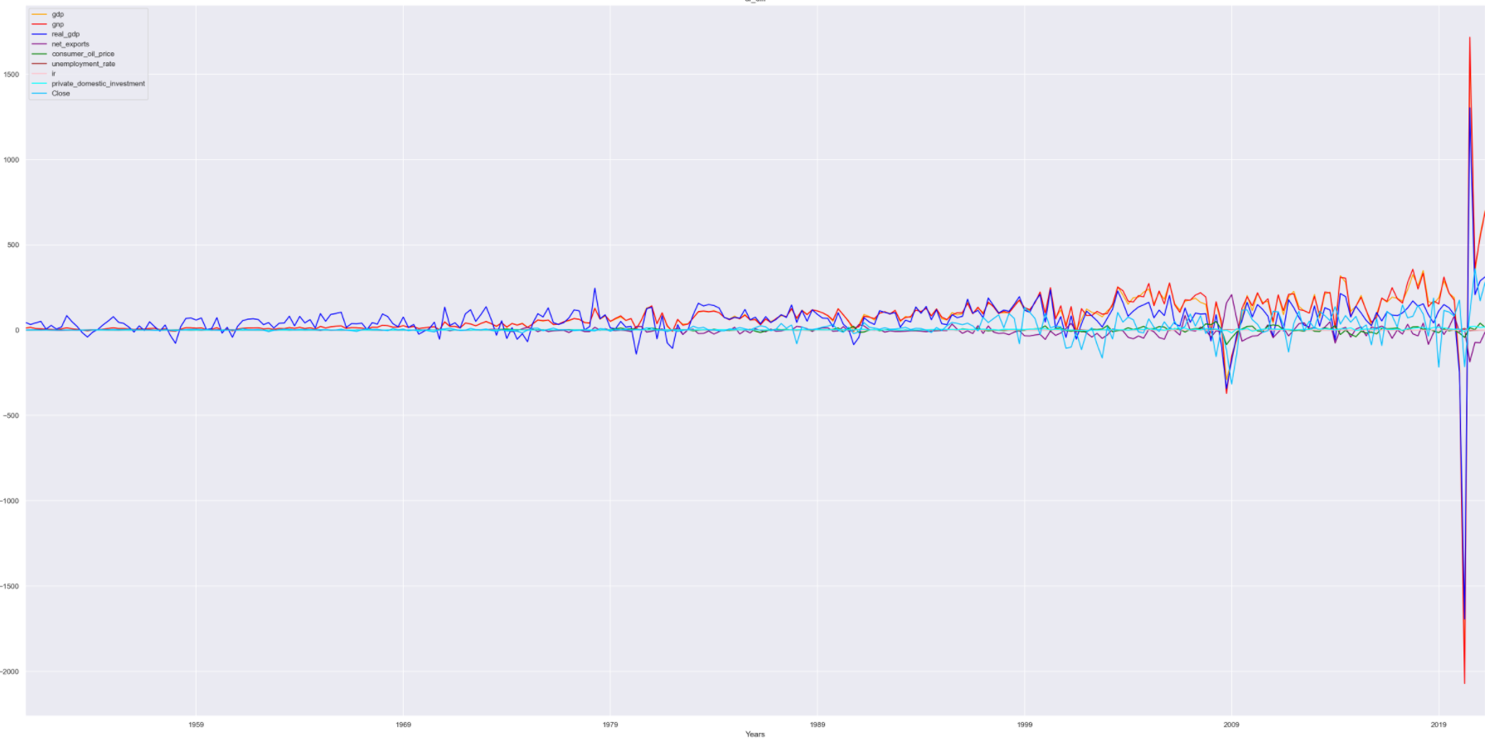
07
Analytic
Visualisation
De-trend data
remove the effects of trend from a data set to show only the differences in values from the trend
allows patterns to be identified
Notes:
state the 3 ways we detrended our data
Here you can see just how different the time series becomes when we're looking at absolute difference

Slide 10
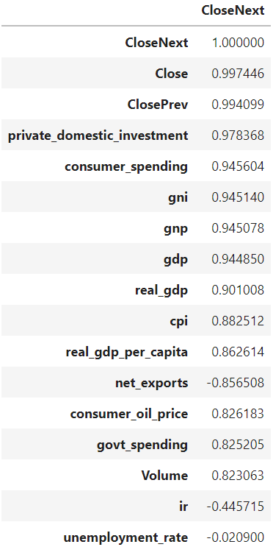
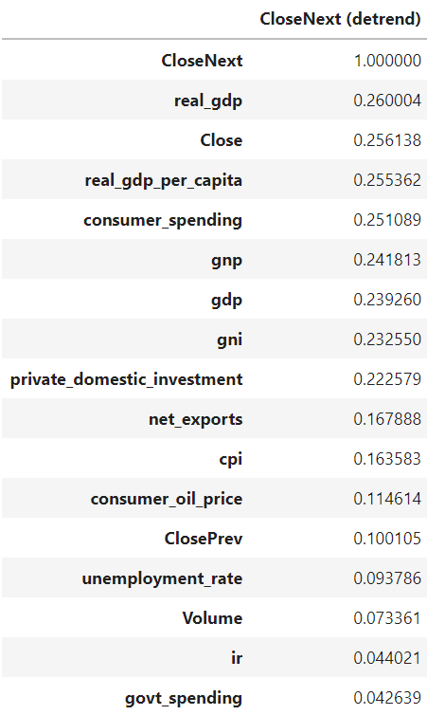
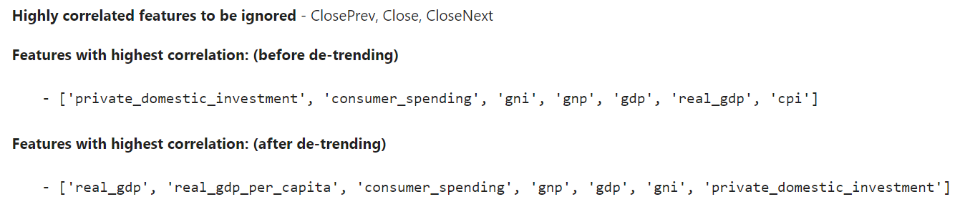
07
Analytic
Visualisation
Correlations before & after de-trending
Notes:
Show how correlations and their rankings vary before and after detrending - importance of detrending

Slide 11
08a
Machine Learning I
Multiple Polynomial Regression
1. select features
Notes:
By focusing on these top-correlated features, we ran the model several times with different combinations of these features, and found that the most reliable results are achieved when these 5 features.

Slide 12
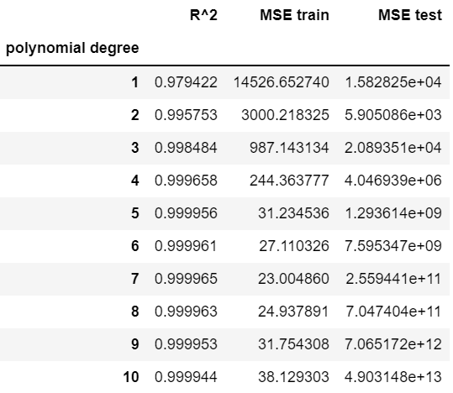
08a
Machine Learning I
Multiple Polynomial Regression
2. select polynomial degree
Notes:
For polynomial degree, the lowest MSE (from test set) is achieved at polynomial degree 2.
Beyond degree 2, we see overfitting

Slide 13
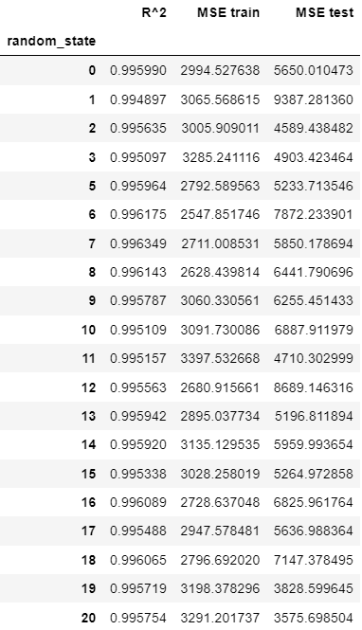
08a
Machine Learning I
Multiple Polynomial Regression
3. collect MSEs of 1001 runs
4. remove outliers
Notes:
Running 1001 regressions took less than 15sec

Slide 14
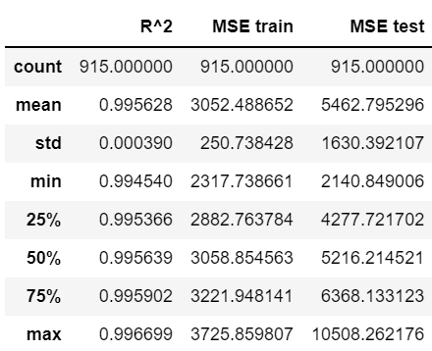
08a
Machine Learning I
Multiple Polynomial Regression
5. statistical description
Notes:
For polynomial degree, the lowest MSE (from test set) is achieved at polynomial degree 2.
Beyond degree 2, we see overfitting

Slide 15
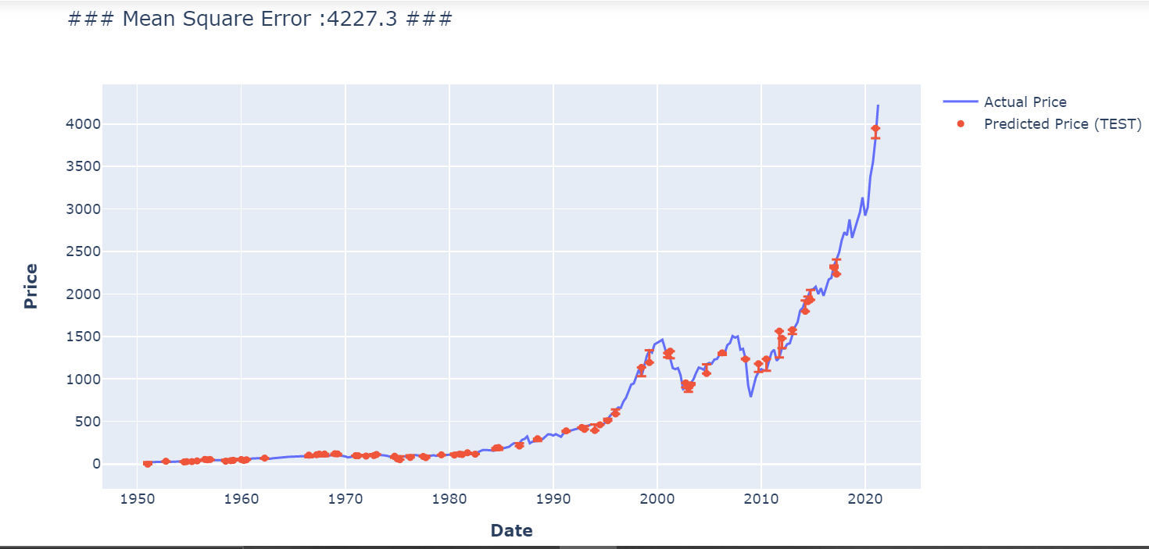
Multiple Polynomial Regression
Visualised Results (with median R^2)
Notes:
Here you see our test set results from the train-test-split with median train R^2

Slide 16
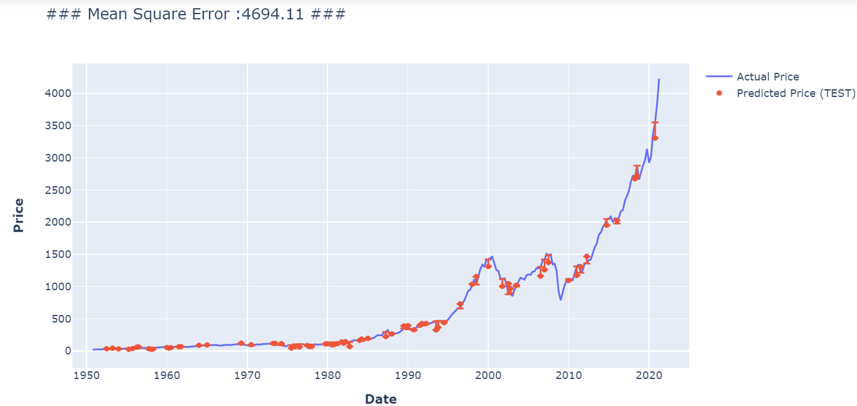
Multiple Polynomial Regression
Visualised Results (with median MSE)
Notes:
Here you see our test set results from the train-test-split with median train MSE

Slide 17
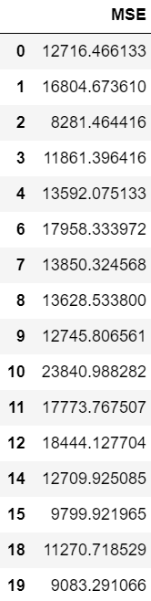
08b
Machine Learning II
Long Short-Term
Memory (LSTM)
1. collect MSEs of 20 runs
2. remove outliers
Notes:
For LSTM, we were only able to run 20 models, as each run already took 1-2min

Slide 18
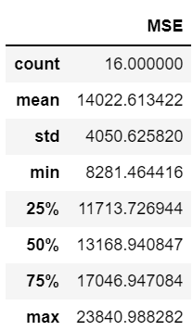
08b
Machine Learning II
Long Short-Term
Memory (LSTM)
3. statistical description

Slide 19
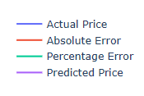
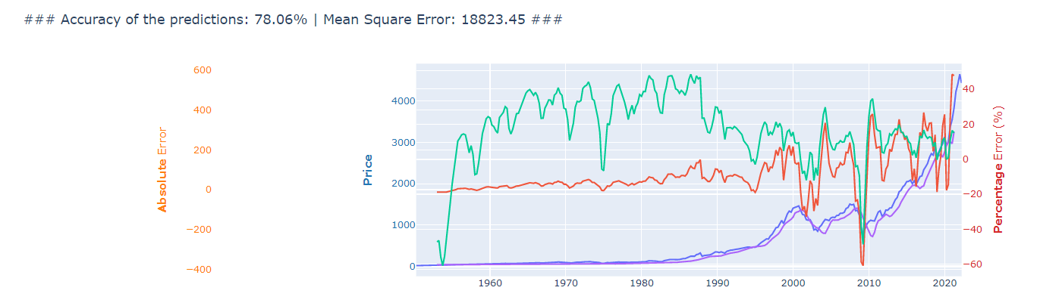
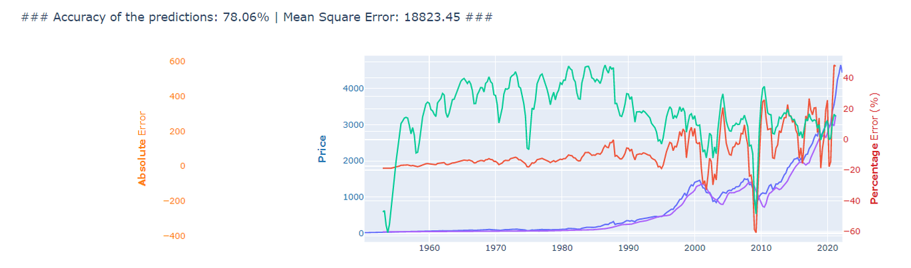
Long Short-Term Memory (LSTM)
Visualised Results

Slide 20
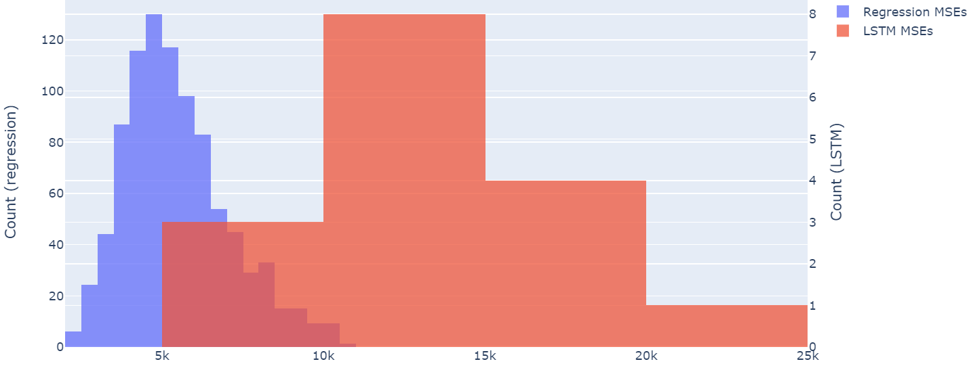
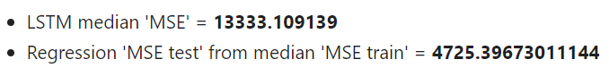
09
Statistical
Inference
Median Comparison
Regression's MSE is 64.6% less than LSTM's

Slide 21
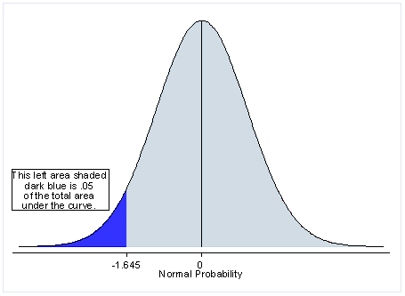
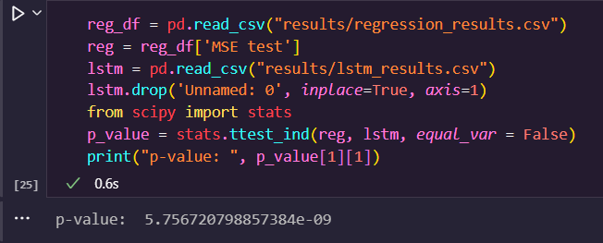
09
Statistical
Inference
Hypothesis Testing:
h0= "both means are equal",
h1= "lstm mean is higher than reg"
Reject h0 at 99%
confidence level

Slide 22

10
Intelligent Decision
Regression model performs much better than LSTM because it doesn't assume that the past indicates the future.
It puts more emphasis on understanding the relationship between the economic situation & market sentiment to stock prices.
Notes:
In conclusion, it is undoubted that our regression model far outperforms LSTM
So how does this address our formulated problem?
We identified a weakness of LSTM - it fully relies on past data to predict the future.
But often times, the past is not a good indicator of the future, more so due to the stock market's volatile nature
Our multiple polynomial regression, on the other hand, collects current economic indicators and uses these as an indicator of future performance, which turned out to achieve much better results.
This is because by understanding the relationship between econ indicators and stock price, our regression model is able to take into account of external factors like the econ situation and market sentiment of a country, which impact stock prices much more than past trends.

Slide 23
Recommendations
Use both past trends and current economic situations as predictors
Try weekly/daily data instead of quarterly/monthly data for higher precision
Use market sentiment indicators - convert news headlines to measurable parameters
Use simpler models whenever possible eg. LSTM vs regression
Always de-trend
Select only top-most correlated ones to prevent overfitting
Notes:
1) Based on these insights (from previous slide), we recommend designing a predictive model that takes both past trends and current economic situations as predictors
2) Use weekly/daily data instead of quarterly/monthly data for more precise results i.e. quarterly/monthly data (e.g. GDP) can be converted to weekly/daily data by repeating the same values within the same quarter/month
3) Bring in market sentiment indicators i.e NLP tools that scrapes and convert news headlines to measurable market/economic parameters
4) Use a simpler model whenever possible
- less time and resources means we are able to run more tests model e.g. we could run 1000 regressions in less than 15sec, but 20 LSTMs would already take 20-30min -> being able to run more tests allows us to better assess and refine model e.g. our good old regression ended up outperforming LSTM by a large margin
5) Always de-trend to ensure correlation is not a result of general trend
6) Select only top-most correlated features to avoid overfitting

Slide 24
Thank You! :)

